Slide 1

Project Title - SEASONAL AGRICULTURE PERFORMANCE ANALYSIS
Name : Atharva Abhaykumar Datar
College Name : Dr. Babasaheb Ambedkar Technological University , Lonere
AICTE STU ID : STU671fb73abc7fa1730131770

Slide 2

PROBLEM STATEMENT
Agricultural performance varies across seasons.
Environmental conditions, farming practices and resources affect outcomes.
Raw data does not clearly show seasonal patterns.
This project analyzes yield, resources, environmental factors and profitability across seasons.
Aim: Generate data-driven agricultural insights.

Slide 3
Project Description
Dataset: 4,000 records, 28 attributes
Seasons: Kharif, Rabi & Zaid
Covers crops, locations, environment, irrigation and economics.
Performed:
Data cleaning
EDA
Seasonal comparison
Correlation analysis
Statistical testing
Visualization
Goal: Identify meaningful seasonal patterns and insights.

Slide 4

WHO ARE THE END USERS?
👨‍🌾 Farmers — Crop & resource planning
🌾 Agricultural Planners — Seasonal decision-making
🔬 Researchers — Agricultural pattern analysis
🏛️ Policy Makers — Evidence-based planning
💼 Agricultural Businesses — Production & profitability analysis

Slide 5
Technology Used
Language: Python
Libraries: Pandas, NumPy, Matplotlib, Seaborn, SciPy
Tools: Jupyter Notebook, Visual Studio Code
Techniques: Data Cleaning, EDA, Correlation Analysis, ANOVA, Data Visualization

Slide 6
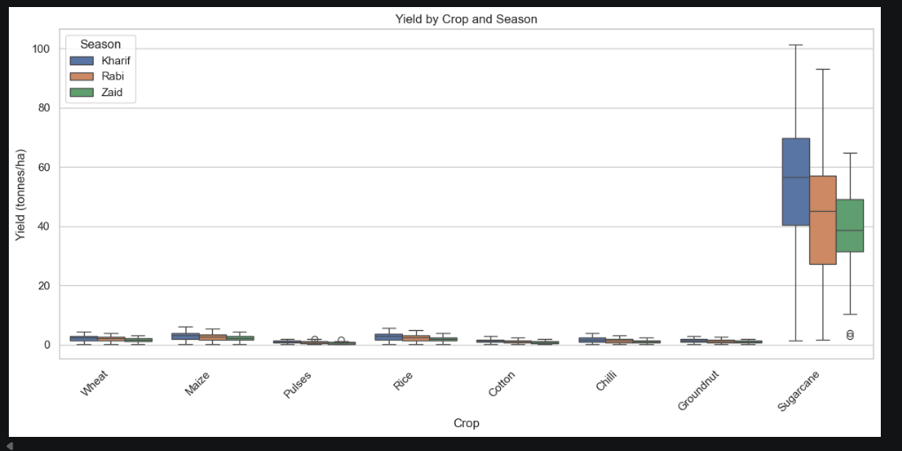
RESULTS

Slide 7
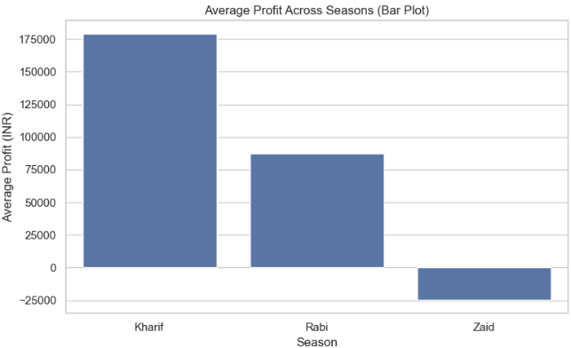
RESULTS

Slide 8
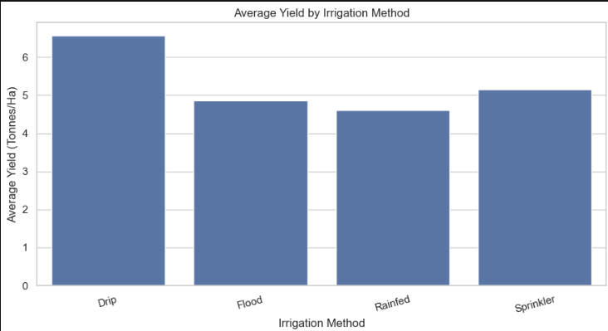
RESULTS

Slide 9
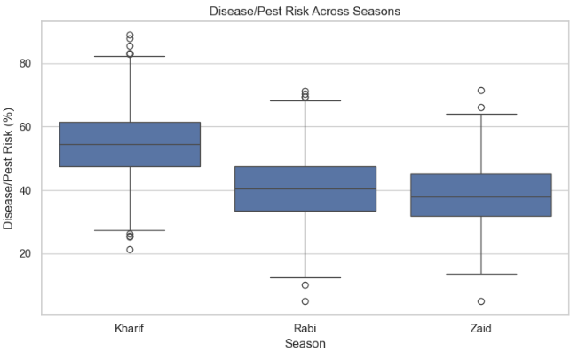
RESULTS

Slide 10
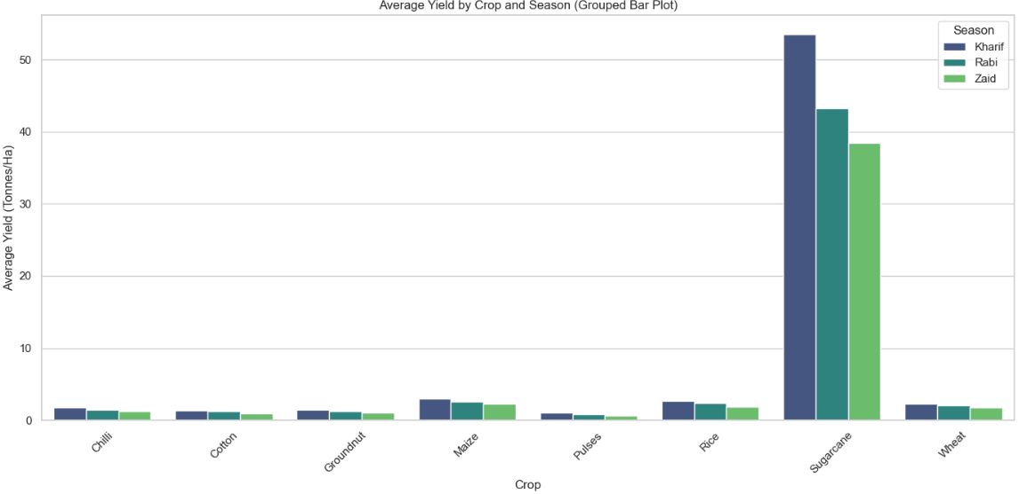
RESULTS

Slide 11
Future scope
Yield and profit prediction
State/District-level analysis
Weather data integration
Crop recommendation system
Resource optimization
Multi-year time-series analysis

Slide 12
GitHub Link
https://github.com/AtharvaDatar2004/Seasonal_Agriculture_Performance_Data_Analytics

Slide 13
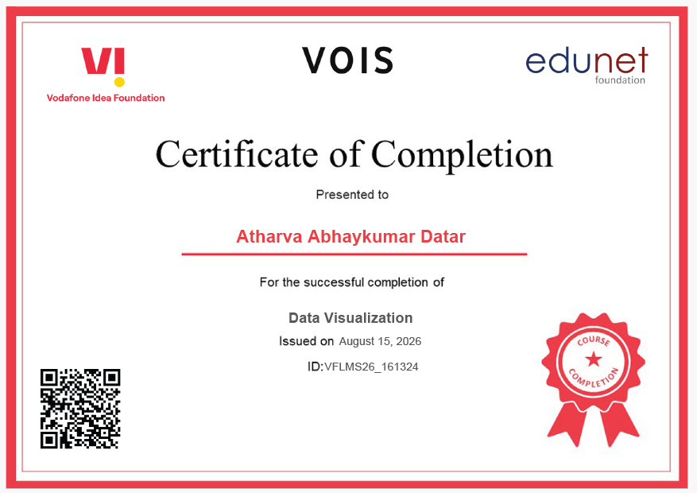
VOIS Course completion certificate - Course name- Data Visualization

Slide 14
Thank you
.
.

